Slide 1
Spatial Analysis for DEVS Models
Omar Kawach
Supervisor: Dr. Gabriel Wainer
Mentor: Bruno St-Aubin
Notes:
Explain weekly meetings and spatial analysis work, conceptual work was through discussion

Slide 2
Motivation
In many application domains, Modelling and Simulation (M&S) has shown to be useful to study real world systems and to support decision-making through models that abstract the systems under study.
Building accurate models that adequately represent real-world systems is a difficult and time-consuming task that requires extensive domain knowledge and a deep understanding of the simulation method used.
This is even more a challenge in the case of highly complex, large-scale, spatial systems such as emergency response services, urban logistics, natural resource exploitation, socio-economic policies, etc.
GIS data contain highly detailed, often hierarchically organized information that can be used to build simulation models.
It is inherently compatible with the hierarchical and modular nature of the DEVS formalism
Notes:
Inheritance
Modelling and simulation can support decision makers through models that abstract systems under study. Building accurate models is both difficult and time consuming, .
GIS follows parent-child relationships (inheritance)

Slide 3
Objective
The goal is to develop a method to automate the generation of large-scale, spatial DEVS simulation models from GIS data
The first step is to determine how GIS data can be used to build complex, large-scale spatial DEVS models.
This work seeks to answer several questions for future, more extensive research on the topic:
Which type of scenarios can GIS data help us model?
Which spatial analysis tools can be used? How can they be used?
What is a typical workflow that can convert GIS data into a simulation model?
How can DEVS models be parameterized from GIS data?
How can neighborhoods or couplings be derived from spatial properties?
Notes:
First goal not accomplished yet, end goal

Slide 4




Open Source Software / Libraries
QGIS – GIS application for the analysis of spatial data
GeoDA – GIS application for spatial autocorrelation
GeoPandas – Python library to work with spatial data
Shapely - Manipulate and Analyze Geometric Objects

Slide 5
Model Generation Workflows
Before modelling, the following questions must be answered:
Is the real-world system to model a spatial system?
Are there any spatial relationships that can be used?
Is geospatial data available?
Data is easy to find, good, complete data? not so much
Can the data be geo-processed?
Are the right tools available? Is the hardware required available?
If all questions are answered, then we can consider a model generation workflow:
Spatial Analysis
Mapping
Data
Derived data
DEVS Model
Notes:
Not a solution for everything (first point) if we don’t care about neighbours for example
Basic / Generic workflow, can map data directly

Slide 6
COVID-19 Spread Model
Tobler's First Law (TFL) of Geography
“Everything is related to everything else, but near things are more related than distant things” – Waldo Tobler, 1970
TFL plays a significant role in spatial autocorrelation statistics
First mentioned in a paper on the simulation of urban growth in Detroit
Spatial analysis models can offer insight into infectious disease spread and outbreak susceptibility in geographic regions based on spatial weighting
General modeling workflow: Join attribute data with geometries and calculate spatial weights
Data:
Confirmed COVID-19 cases (Ottawa Public Health)
Ottawa wards (Open Ottawa)
Ward populations (Statistics Canada)
Notes:
Pg 236

Slide 7
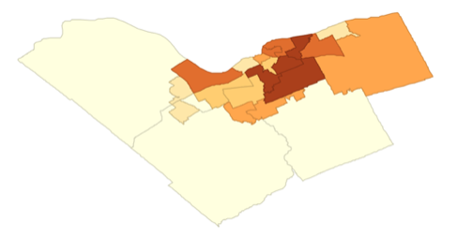
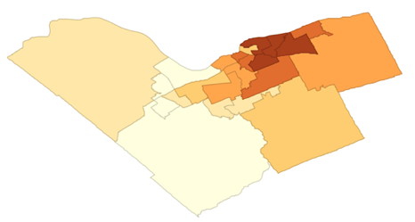
COVID-19 Spread Model Cont’d
Spatial Autocorrelation
Data source Spatial analysis task Couplings or neighborhood DEVS model (A or C) Final model
Density of Disease Cases
Probability a Ward is impacted by Neighboring Cases
Geographic Regions
Map onto COVID Model
Geographic Regions Infectious Disease Susceptibility
Population Counts
Data Join
Geographic Regions with Case and Population Statistics
COVID Cases
Spatial Weight
Geographic Region Connectivity Statistics
DEVS Model
Notes:
Trivial to add atomic or coupled model since …

Slide 8
Emergency Services Model
Champlain Local Health Integration Network in Ontario proposed a protocol where at-home COVID testing could be done by trained paramedics to ease the pressure on hospitals.
First Responder resources could be saved by assigning hospitals to buildings (or dissemination areas) through shortest path network analysis.
The model can also be expanded further to consider health conditions of residents in a building
General modeling workflow: Intersect buildings with DAs, find closest hospitals with road network.
Data:
National Road Network (Open Canada)
Building Footprints (Open Ottawa)
Hospitals (Open Ottawa)
Dissemination Areas (Open Ottawa)
DAs are the smallest standard geographic area for which all census data are disseminated (Statistics Canada).

Slide 9
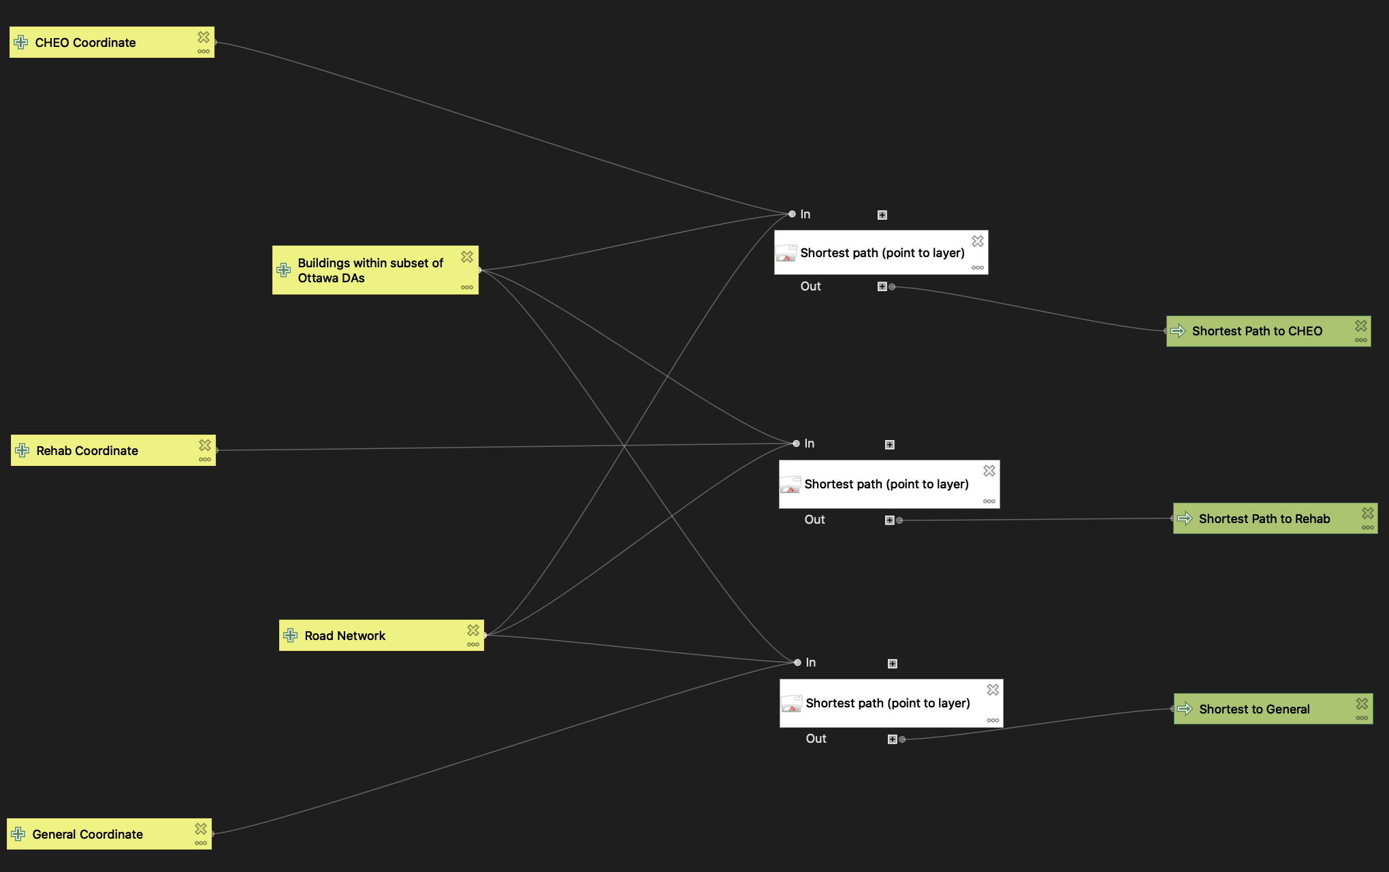
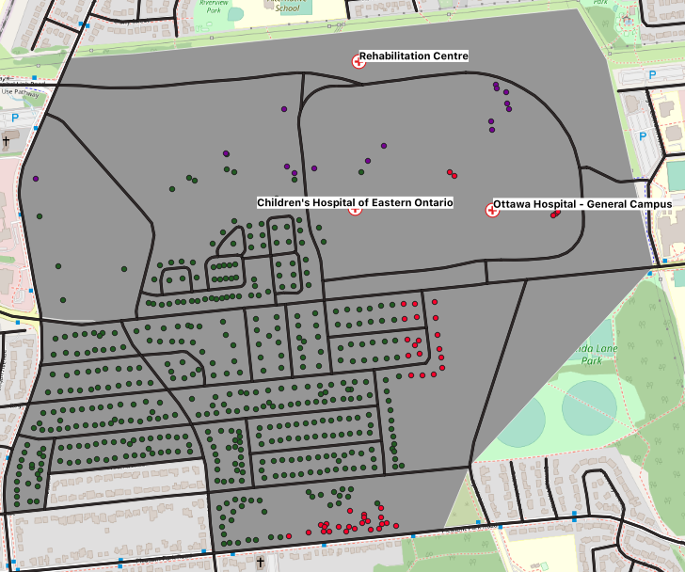
Emergency Services Model Cont’d
On a small study area, QGIS’ graphical modeler automates most tasks
Advantage: can be exported as a Python script
Disadvantage: not all QGIS algorithms are available in the graphical modeler
Automate Finding the Shortest from Building to Hospital
Buildings Colored by their Closest Hospital

Slide 10
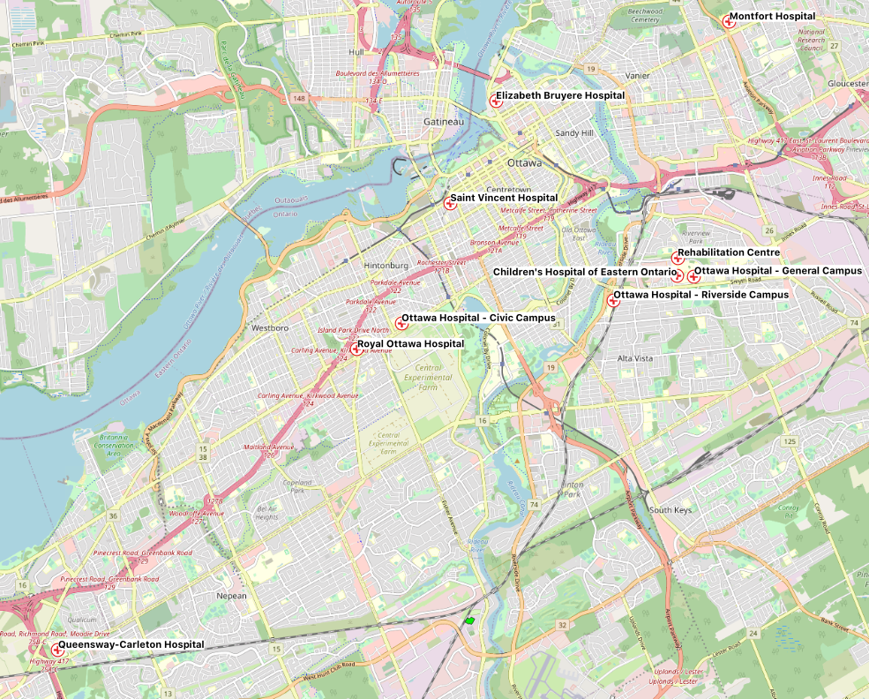
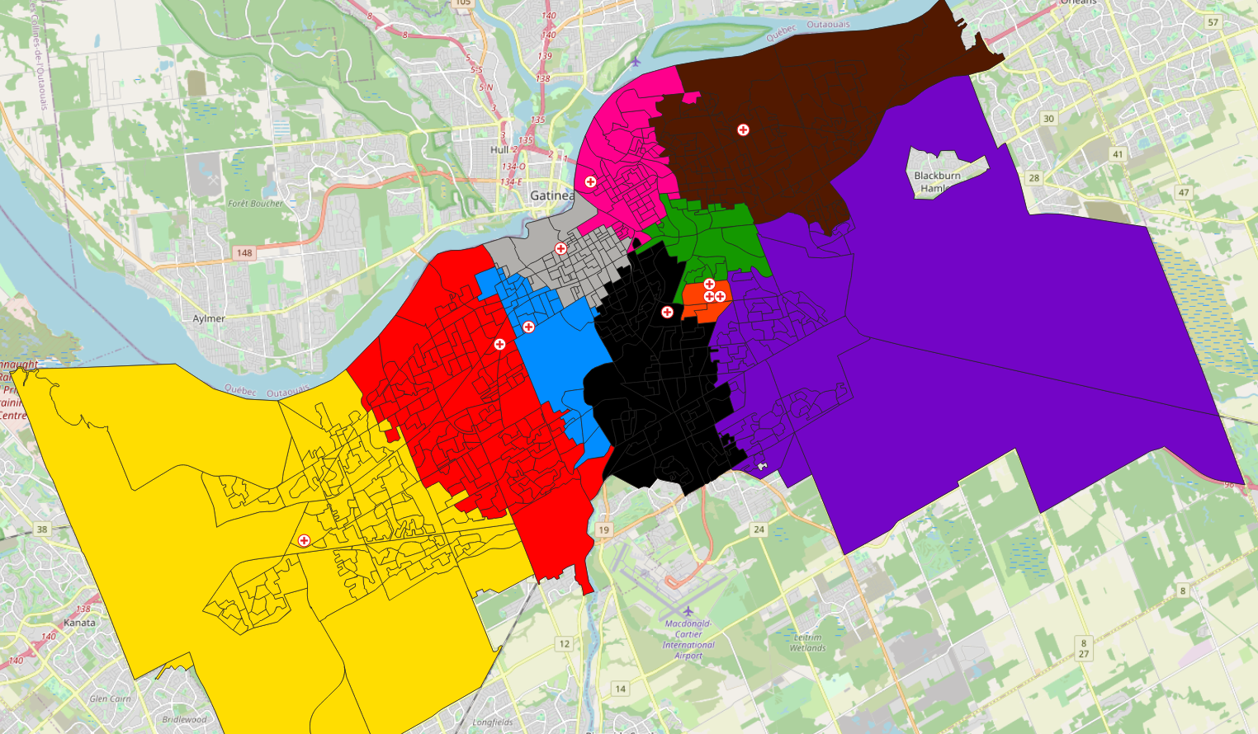
Emergency Services Model Cont’d
All the Hospitals Located in Ottawa
Dissemination Areas Colored by their Nearest Hospital
Notes:
Parent-child relationship (hospitals belong to DA)

Slide 11
Emergency Services Model Cont’d
Map onto Residence Model
Residences
Data source Spatial analysis task Couplings or neighborhood DEVS model, atomic or coupled Final model
Buildings Atomic
Spatial Intersection
Buildings within DAs
Can be automated by QGIS Graphical Modeler
Map onto Health Unit Model
Emergency Services DEVS Model
Road Network
DAs
Health Units Coupled
Road Distance
Closest hospital to DA
Map onto Hospital Model
Hospitals
Hospital Atomic

Slide 12
Prescription Delivery Model
The delivery app market has become a hot market.
Companies that currently run prescription delivery generally lack economic moat.
A pharmacy chain like Shoppers already has established customers and buying power for new technologies. If they were to release a prescription delivery app, they would likely dominate the market.
General modeling workflow: Apply Network Analysis and Voronoi Polygons as a delivery solution in Urban Logistics
Data:
National Road Network (Open Canada)
Building Footprints (Open Ottawa)
Shoppers Drug Mart Locations (Extracted Manually from Google Maps)

Slide 13
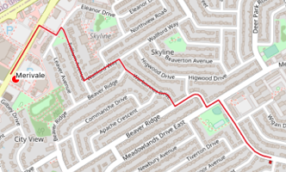
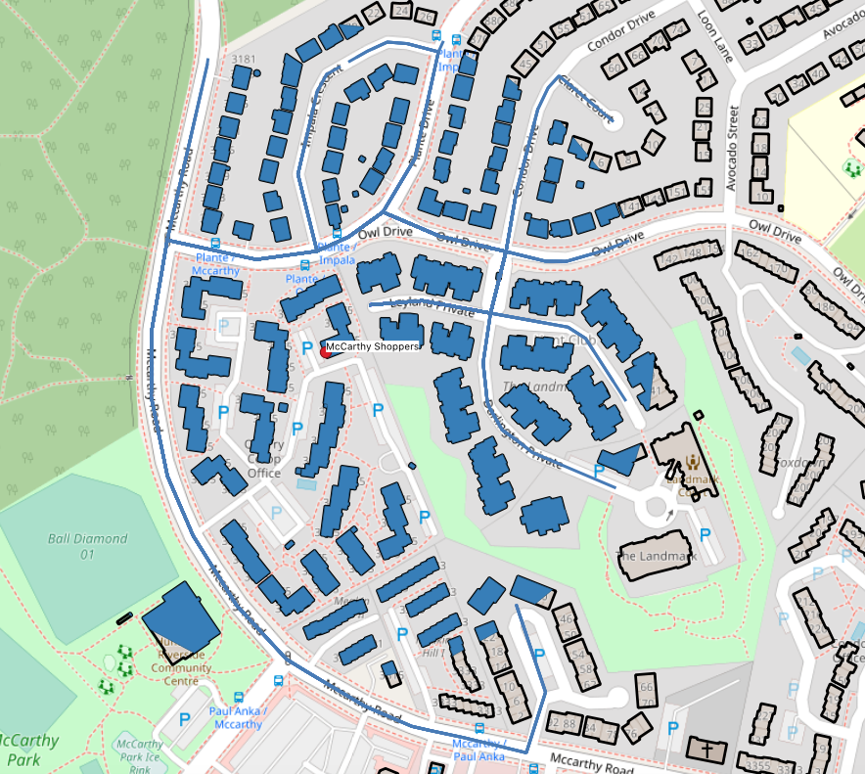
Prescription Delivery Model Cont’d
Data source Spatial analysis task Couplings or neighborhood DEVS model, atomic or coupled Final model
Building Footprints
Spatial Intersection
Path from Customer to Closest Pharmacy
Customers within Delivery Service Buffer
Delivery Service Buffer
Distance Buffer
Spatial Intersection
Pharmacy-Customer Couplings
Pharmacies
Voronoi Polygon
Customers within Delivery Service Buffer
Road Distance
Distance to Pharmacy
Map onto Pharmacy- Customer Model
Pharmacy- Customer Atomic Models
Delivery Service Coupled Model
Road Network

Slide 14
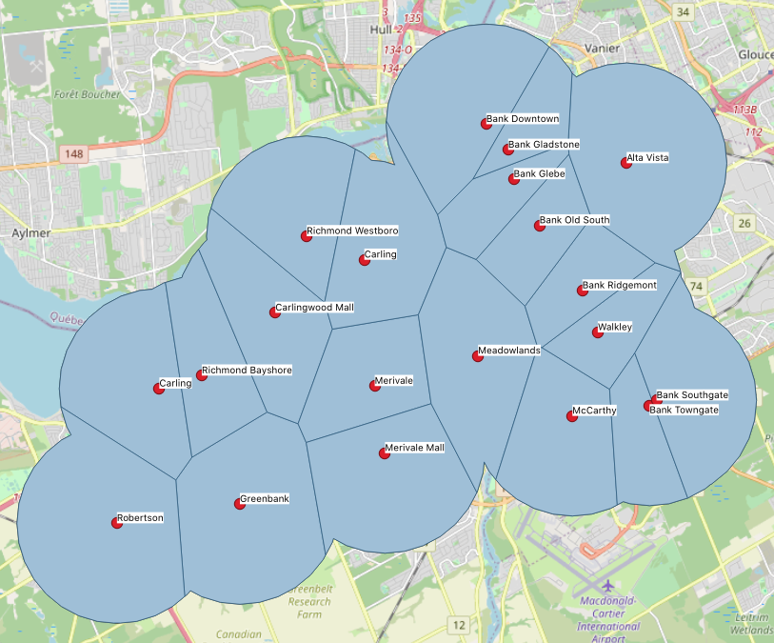
Prescription Delivery Model Cont’d
Voronoi Polygons
Collection of polygons where each polygon is partitioned based on their minimal distance to a point (in this case, a pharmacy)
Advantage: Faster than using shortest path algorithm to find the closest pharmacy for each customer building
Disadvantage: Might intersect with data outside of study area if we aren’t too careful (Gatineau)
Delivery Service Buffers Determined by Voronoi Polygons
Notes:
House would emit an event (send order) to pharmacy (receive message, external transition function) and modifies the time advance function (prepare medicine in 2hrs) and then output (medicine) to house (delivery person)
Time advance function (after x amount of time, do an internal transition (changes state of model then outputs), cost already calculated)
Change colors (need prescription after one week), only concern is what happens during event
Not computing useless information, can change parameters will we be overwhelmed

Slide 15
Emergency Response Model
In the Ottawa-Gatineau region, sandbagging is commonly used as a line of defense against flooding to protect homes and other property.
GIS task: Use multi-ring buffers and spatial interpolation to develop an approach to help first responders decide where they should deploy sandbags
Could be extended further to calculate number of sandbags required
General modeling workflow: Query waterbodies, build buffers using elevation, intersect with buildings
Data:
National Road Network (Open Canada)
Building Footprints (Open Ottawa)
Dissemination Areas (Open Ottawa)
Elevation Data (NRCan)
Waterbodies (Rideau Valley Conservation Authority)

Slide 16
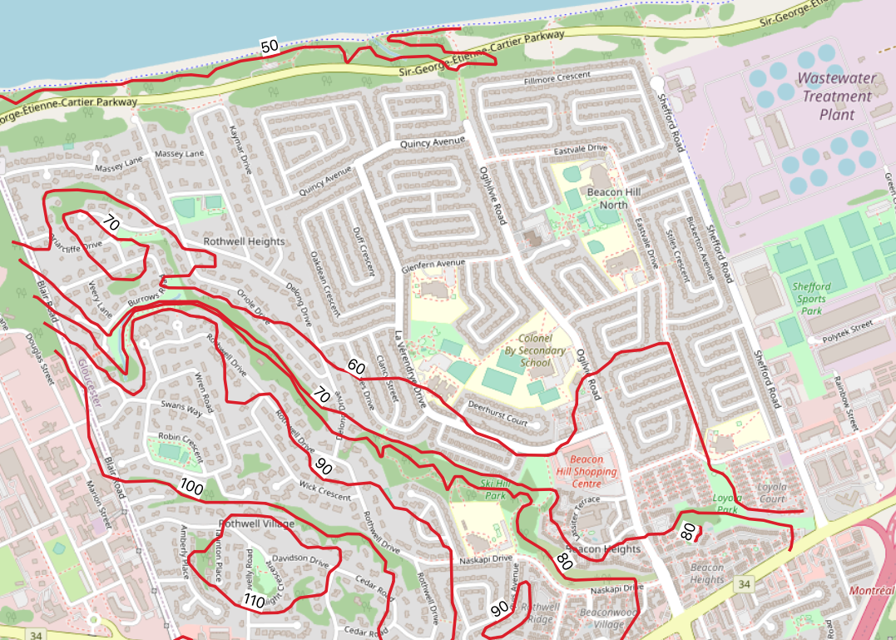
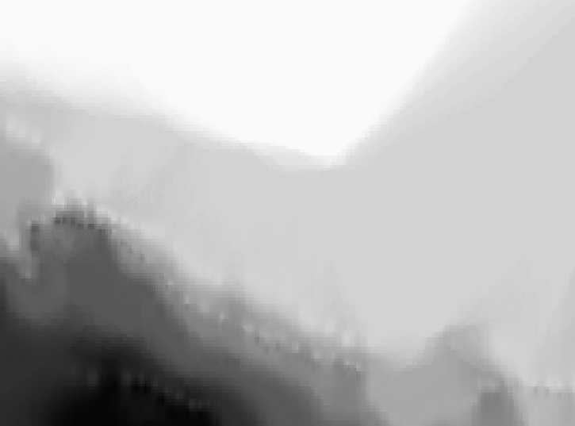

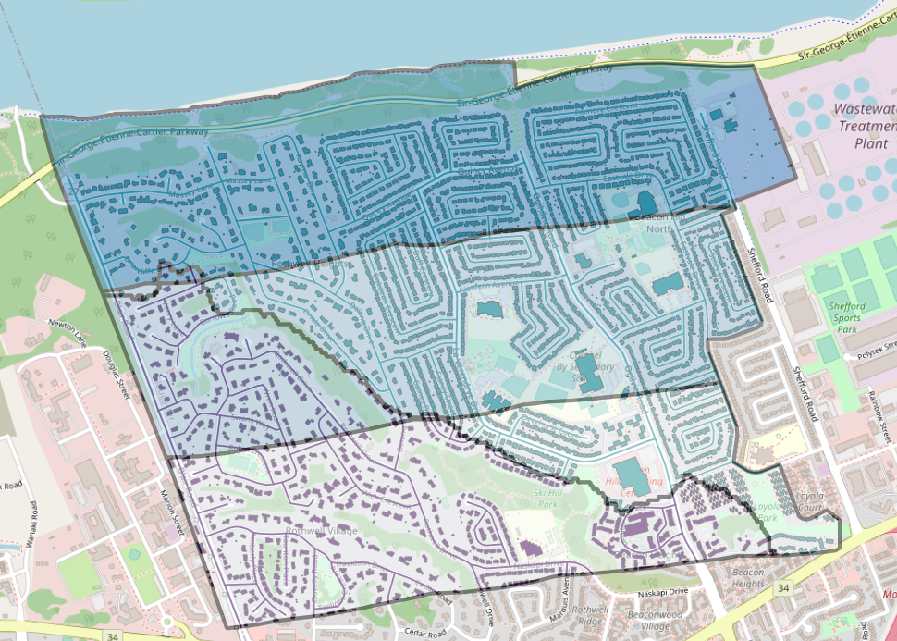
Emergency Response Model Cont’d
Inverse Distance Weighting with Nearest Neighbor
Averages interpolated points
Prefers continuous concentration of points
Would work better for mineral extraction models
Triangulated Irregular Network
Requires more work but is good for surface calculations (elevation data)
Produces a large file since it is computationally expensive
Elevation Contours
IDW with NN on Elevation Contour
Raster Calculator (Below and Above 70m Elevation)
Buildings and Roads at Risk by Danger Zones and Elevations

Slide 17
Emergency Response Model Cont’d
Data source Spatial analysis task Couplings or neighborhood DEVS model, atomic or coupled Final model
Elevation
Spatial Interpolation
Raster Calculator
Raster Layer of Elevation Groups
Polygonise Raster
Waterbody
Multi-Ring Buffer
Flood Zones
Polygon of Elevation Groups
Emergency Response Coupled Model
Buildings
Spatial Intersection
Roads
Spatial Intersection
Buildings, roads, and DAs within Flood Zone
Flood Zones and Elevation Groups
Spatial Intersection
…
Dissemination Areas

Slide 18
Future work
GIS Viewer integration with DEVS Web Viewer
Build library of “toy” models for testing
Small scale implementation
Write paper (Spring 2021)

